Slide 1
Image To Content Generator
Turning Pixels Into Words With Deep Learning

Slide 2
Table of contents
Introduction
Problem Definition
Objective
Ideas
System Architecture
Detailed Design

Slide 3
Table of contents
Tools And Technology used
Screenshots And Video
Results And Discussion
References

Slide 4
Introduction

Slide 5
Introduction
The Image To Content Generator leverages AI to transform images into engaging narratives by combining computer vision with natural language processing .
Using a CNN-based encoder to extract visual features and an RNN-based decoder to generate captions ,the system then inputs these captions into LLaMA 2, a large language model , to create detailed stories .
This project highlights the potential of integrating image captioning with language models for creative applications like content creation, education and entertainment.

Slide 6
Problem Definition

Slide 7
Problem Definiton
In today’s digital world, images are vital for communication, but turning them into detailed stories can be slow and often lacks a personal touch.
The Image-to-Content Generator solves this problem by automatically creating stories, Social Media Content from images, helping users generate interesting and relevant narratives quickly.
This technology can enhance social media posts with catchy captions, create engaging marketing content, and develop interactive learning materials for education. It also simplifies blog writing, sparks creativity for writers, adds context to artworks, and offers personalized storytelling experiences in apps and games.

Slide 8
Objective

Slide 9
Objective
Develop Image Captioning System:
Implement a CNN-RNN architecture to accurately generate descriptive captions from images.
Generate Engaging Content:
Use a large language model (LLM) to convert the generated captions into creative stories, marketing content and social media post content.
Create a User-Friendly Interface:
Design an intuitive web application that allows users to upload images and receive generated content effortlessly.

Slide 10
Ideas

Slide 11
Ideas
Image Captioning:
Process: CNNs extract features from images, while RNNs generate descriptive sentences based on those features.
Language Models:
Llama is a large language model that creates engaging narratives from image captions.
Applications:
Uses:
Content Creation: Helps produce ideas for blogs and articles.
Advertising Ideas: Inspires innovative concepts based on images.
Storytelling: Generates creative stories from visual prompts.

Slide 12
System Architecture

Slide 13
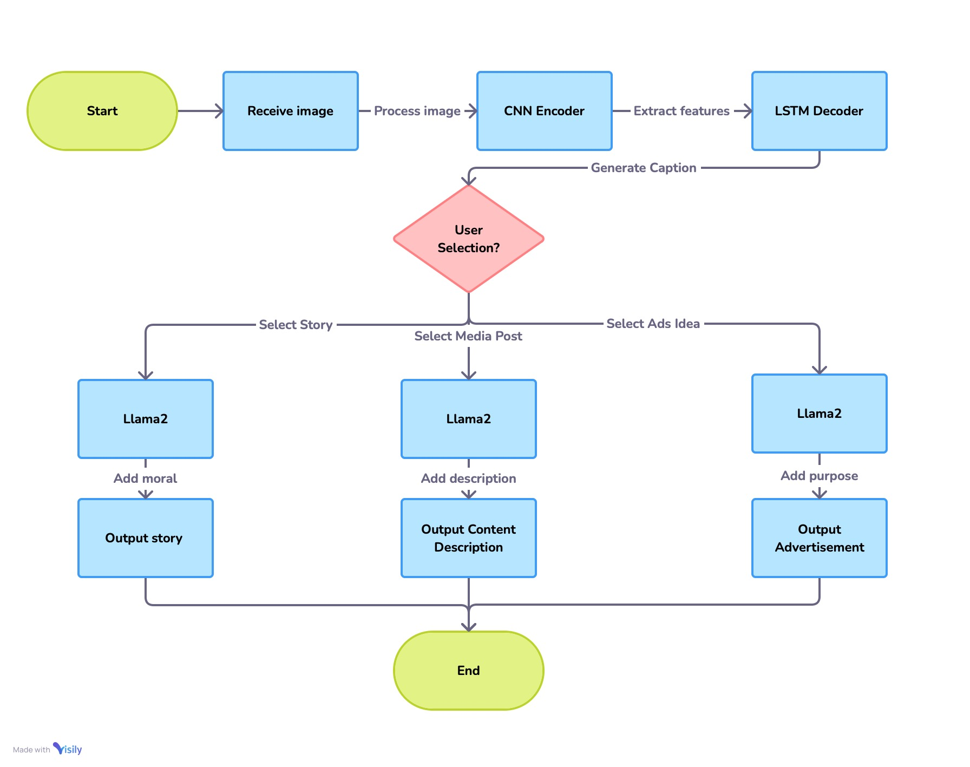
System Architecture

Slide 14
Detailed Design

Slide 15
Detailed Design
ResNet50 Encoder: Pre-trained ResNet50 model processes the image, reducing it to a feature vector.
RNN Decoder: A recurrent neural network (LSTM/GRU) takes the feature vector and generates a sequence of words, forming a caption.
Story and Content Generator (Llama): The caption is fed into the Llama model, which generates an extended narrative. Besides storytelling, the system can also produce social media descriptions and advertisement content based on the image context and caption.
Streamlit Interface: The entire process is accessible through a user-friendly web interface using Streamlit, where users can upload images and receive outputs like stories, social media posts, or advertisement text.

Slide 16
Tools And Technology

Slide 17
Tools And Technology
PyTorch – Deep learning framework used for model training and evaluation.
Convolutional Neural Networks (CNNs) – For image feature extraction.
Recurrent Neural Networks (RNNs) – For sequence prediction and story generation.
LLaMA 2 (Large Language Model Meta AI) – Pre-built LLM for story generation.
Streamlit – For building an interactive user interface.
Torchvision – For image transformations and dataset management.
Pycocotools – For working with COCO dataset annotations.
⁠Matplotlib – For visualizing results.Scikit-image – For image processing tasks.

Slide 18
Screenshots

Slide 19
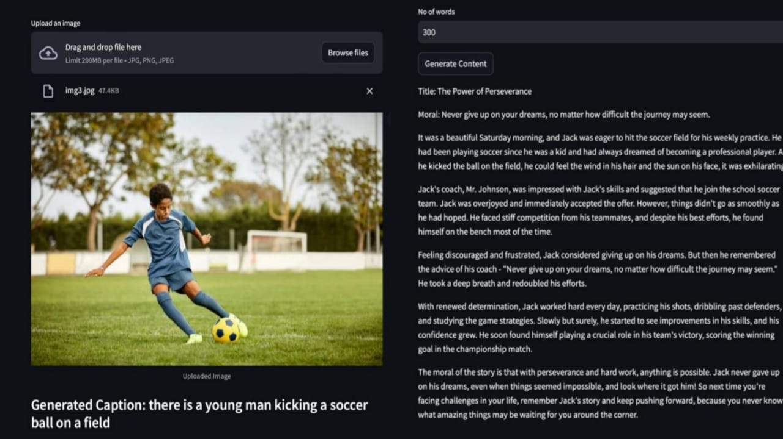
Screenshots

Slide 20
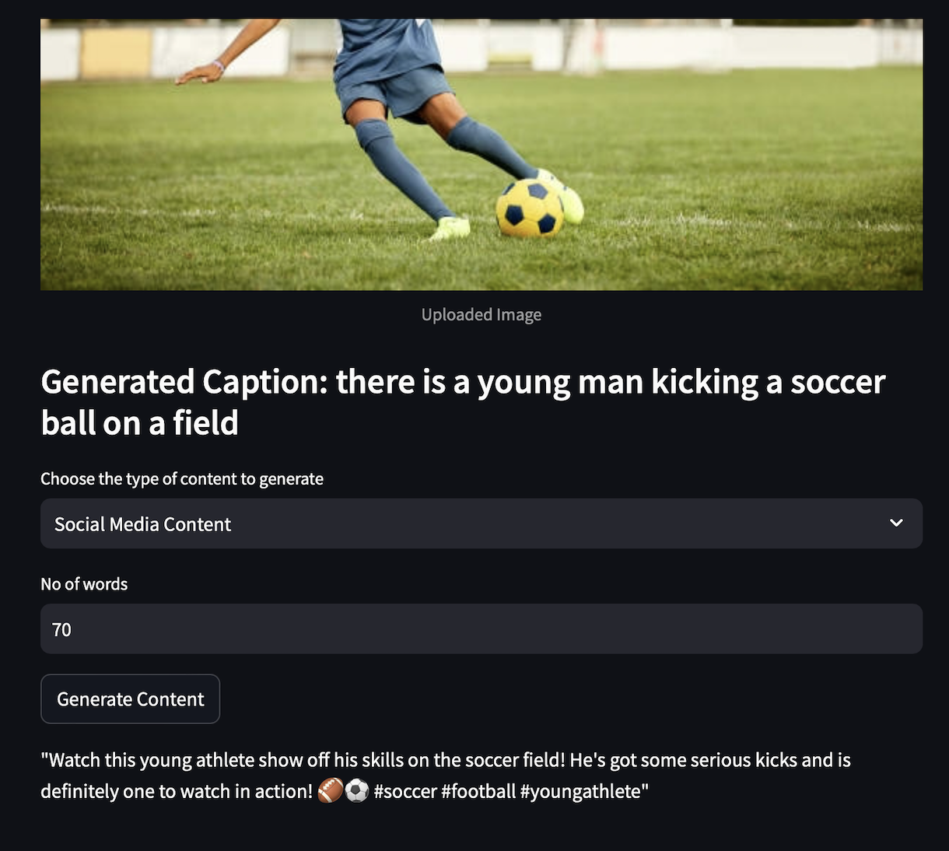
Screenshots

Slide 21
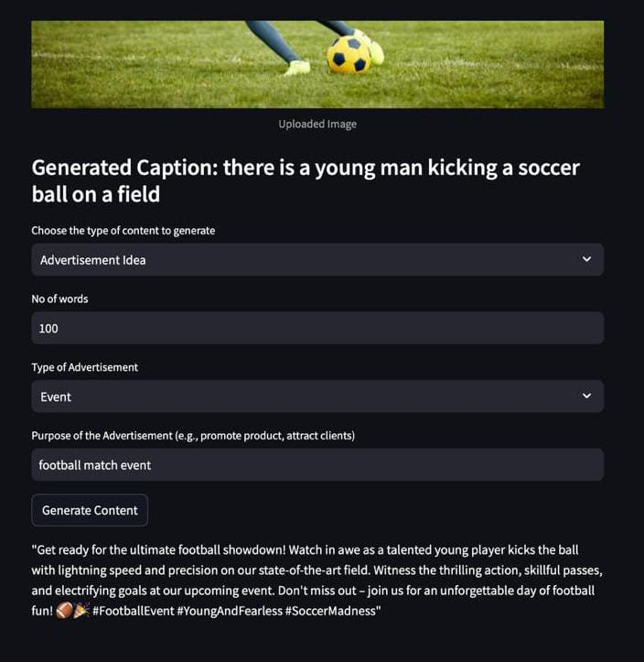
Screenshots

Slide 22
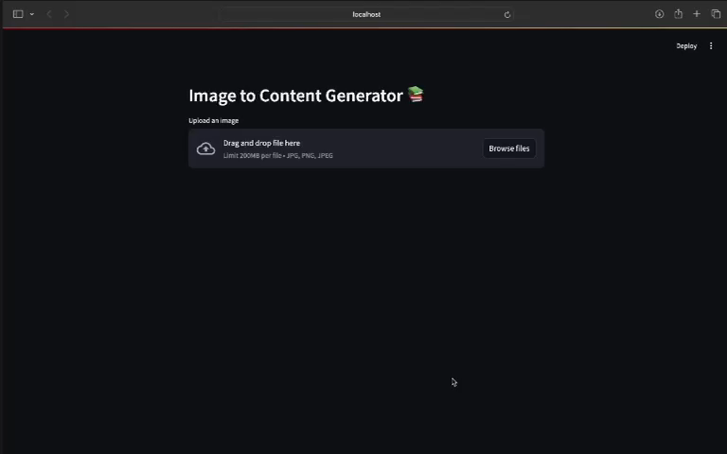
Video

Slide 23
Results And Discussion

Slide 24
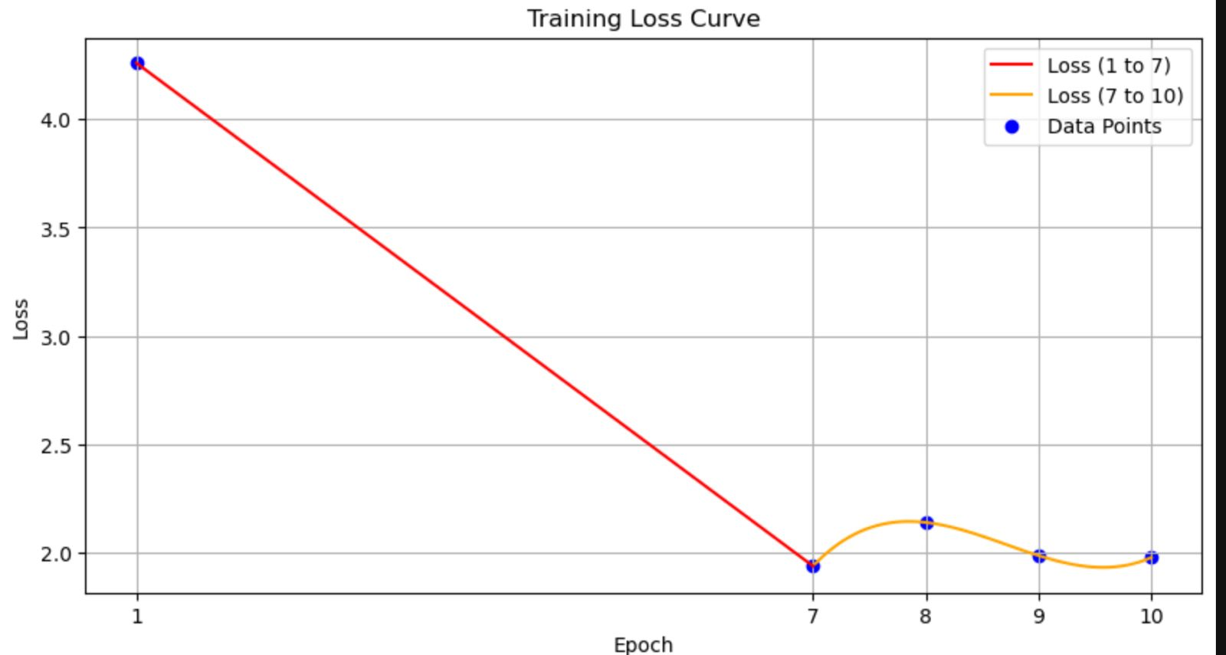
Result And Discussions
More number of epoches will increase accuracy and deacrease loss (atleast 50 epoches)

Slide 25
References

Slide 26
Refferences
Suresh, K.R., Jarapala, A. & Sudeep, P.V. Image Captioning Encoder–Decoder Models Using CNN-RNN Architectures: A Comparative Study. Circuits Syst Signal Process 41, 5719–5742 (2022)
D. Santi, A. A. Ilham, Syafaruddin and I. Nurtanio, "Image Caption Generation Through the Integration of CNN-Based Residual Network Architectures and LSTM," 2024 7th International Conference on Informatics and Computational Sciences (ICICoS), Semarang, Indonesia, 2024

Slide 27
Team
CHAI GANESH J 2022115013
PRAMOTH KUMAR K S 2022115047
SATHEESH KUMAR 2022115105

Slide 28
Thank You

